Slide 1
Mobile Forensics
Lecture 9
Protocol Buffers

Slide 2
What is a Protocol Buffer?
A Protocol Buffer provides a format for taking compiled data (many different languages/platforms supported) and serializing it by turning it into bytes represented in decimal values.
This makes the data smaller and faster to send over the wire. We call this serialization in computer science.

Slide 3
A protocol buffer is a data format structured in a very efficient binary format.
The structure is defined in a .proto file, which is in a readable text format.
the concept is similar to XML, where the schema description can be done inline or in a separate file.

Slide 4
The .proto file is then used to generate code for reading from and writing data to the protocol buffer.
Due to its nature, protocol buffer data is very suitable for transmission over networks. When transmitted over networks, it is often compressed with GZIP to minimize the size of the data.
The protocol buffer concept was created and is used extensively by Google. Other users of protocol buffers include Apple and app developers.

Slide 5
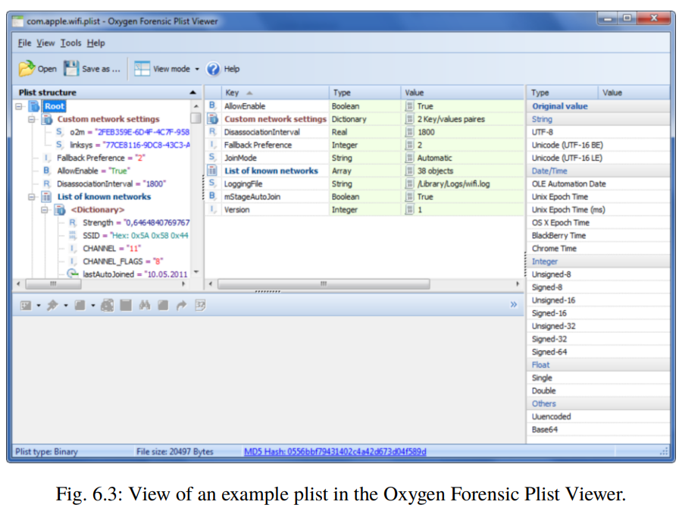

Slide 6
Why are Protocol Buffers Used?
How do we get data through the network faster?
The smaller the data, the faster it will be

Slide 7
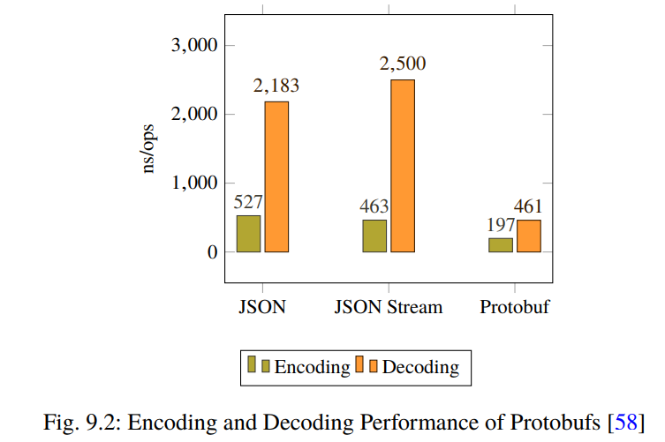
Figures 9.2 and 9.3 demonstrate the time and size of Protbufs, based on tests performed to consider encoding and decoding benchmarks and common browsers

Slide 8
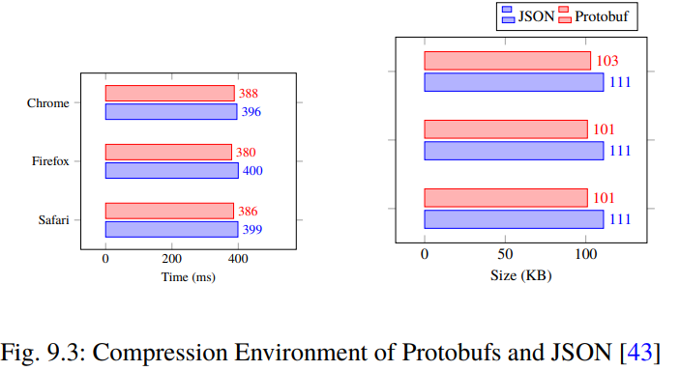

Slide 9
Using Protocol Buffers
generate a description of the message types used and the access service:
Messages
Services
The Proto File
Define the Syntax
Message Type
Fields
Scalar Values

Slide 10
Messages
To create a ProtoBuf message, we must first create an appropriate template. This template is usually saved in a file with the extension .proto.
The file is set up and used alongside another programming language such as Python.
The data (or user data) can be added using the same scheme (Field assignments: Type, Name, Tag) and then sent internally or externally over the wire.

Slide 11
Services
Protocol Buffers are not just about messages but also services. For this reason, we need a service description.
It describes the interface of the methods offered via the service.
If we want to create an RPC service using a proto buffer, then the service must be given a name under which it can later be called once.

Slide 12
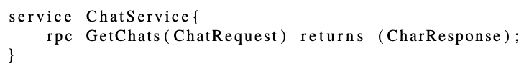

Slide 13
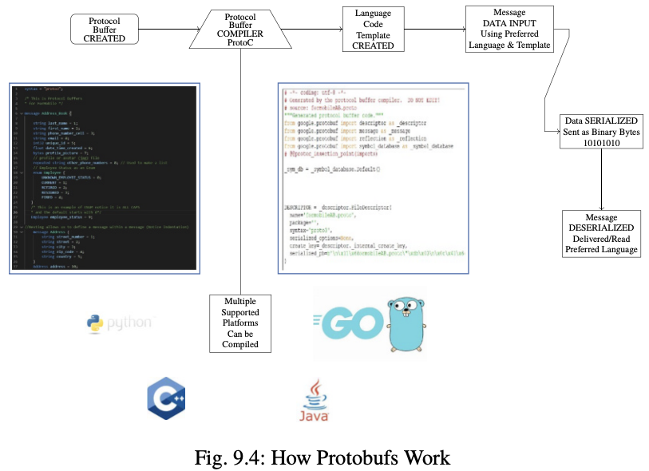

Slide 14
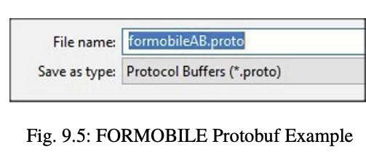
The Proto File
start by creating a .proto file.
this file as the key or legend to the data we will see on a mobile device.
The .proto file is not included with the binary, with a few exceptions.

Slide 15
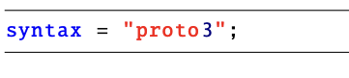
Define the Syntax
Google made Protocol Buffers public in 2008. In 2016 Google published Protocol Buffers 3. Since there is a different version, we have to identify which version of Protocol Buffers will be used. So, the first line of code needs to state this. Version 3 is used in these examples, as shown below.

Slide 16
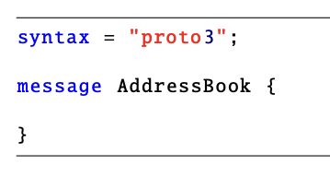
Message Type
the message needs to be defined or named. This "message" is a code term that refers to the data and is not confused with terms chat or SMS text messages. The name should reflect the type of message based on content. The term address book should define our Protocol Buffer just fine. When using two words they use CamelCase and form one word i.e. addressBook or AddressBook, as shown below.

Slide 17
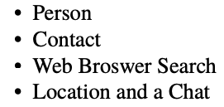
Fields
To create the first property, we need to know the type of data [int32], followed by property name [thread] and then identify it as the sequential property. Fields identify these data characteristics through Field Type, Field Name, and a Field Tag (or also called a Field Number). This is where we define the class characteristics that will be used. We consider what information would we want to know about, for example, a:

Slide 18
Scalar Values
A message is normally composed of a number of different scalar values.
Each value is assigned to a particular type.
Looking at an SQLite database table definition, we will find terms such as Integer, Boolean, Float, and String.

Slide 19
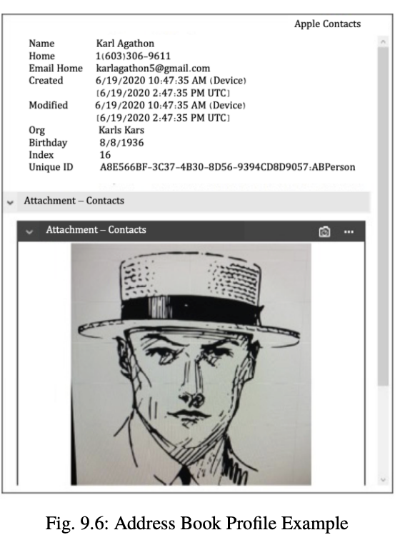

Slide 20
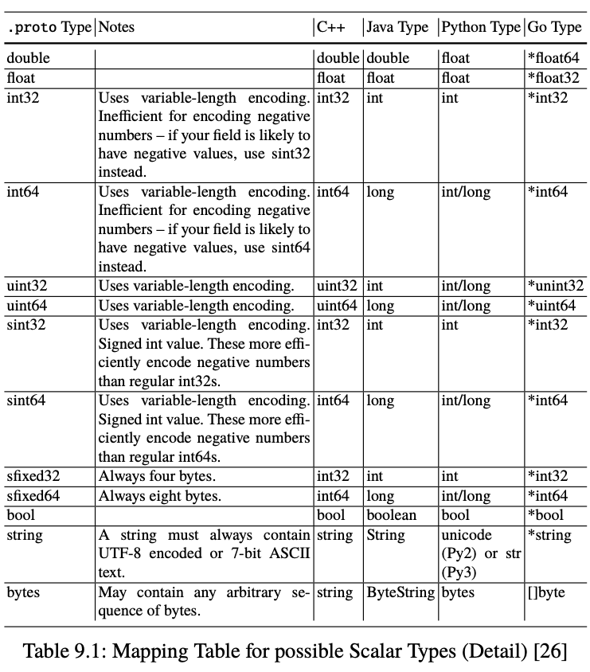

Slide 21
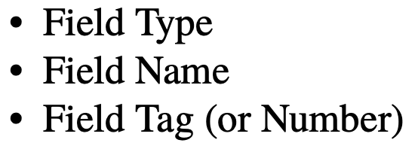
The Schema Defintion
The Protocol Buffer defines the Object (type of data and position).
Not the actual data or user data. The actual data will be coded in Python or another language format.
However, the type of data that will go into these fields needs to be defined.
Protocol Buffers use fields. There are three types of fields:

Slide 22
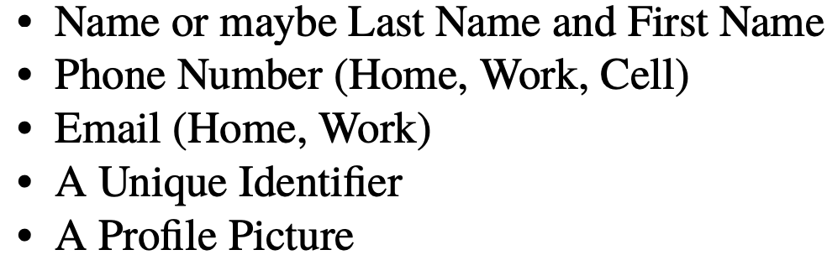
Field Type
The field type uses the scalar values to define the type of data like integer, string, or bool.

Slide 23
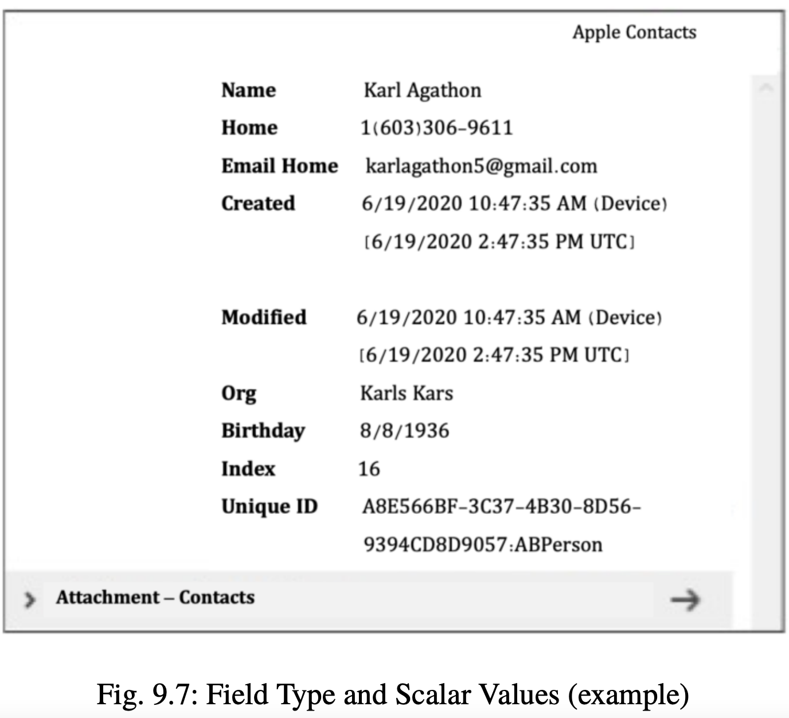

Slide 24
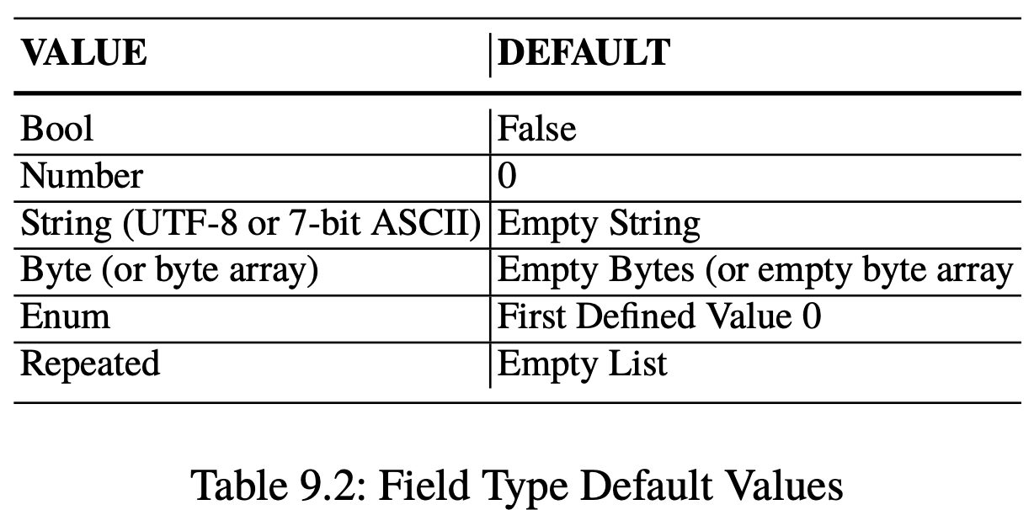

Slide 25
Field Names
The field name represents one particular element within the message, therefore identifying the data for us.
To identify a contact, we may use identifiers such as last_name, first_name, phone_number_cell, email, unique_id, date_time_created, profile_picture.

Slide 26
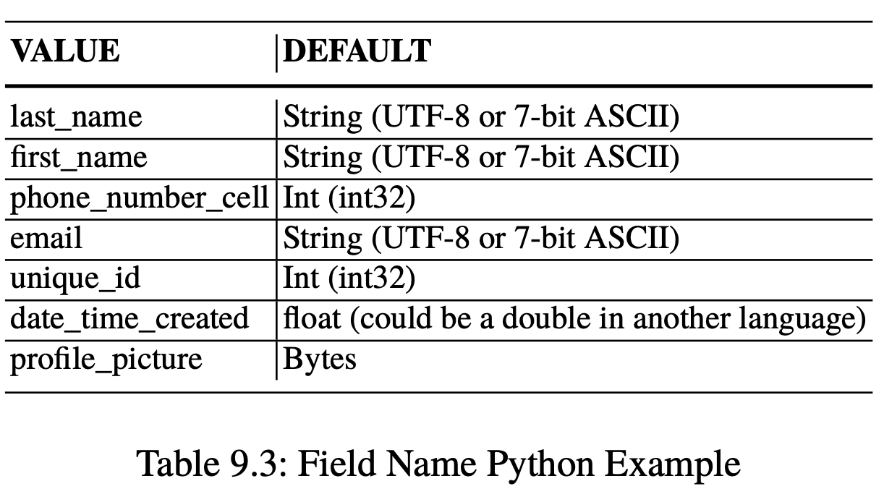

Slide 27
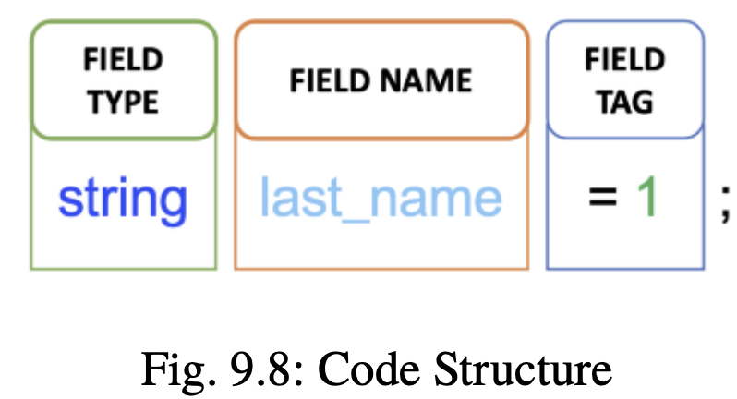
There are also some strategies to speed up the data with these tags:
• Numbers 1 to 15 use only 1 byte, so these are used for fields used most often.
• Numbers 16 – 2047 use 2 bytes
Now we put this together in the code with the Field Type, Field Name, and Field Tag

Slide 28
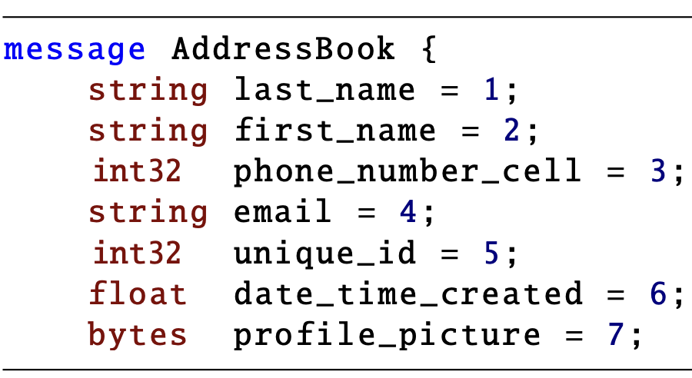
A correct schema definition for our address book example could thus look like the following:

Slide 29
Enums
An Enumeration (Enum) is used when the values for a field are known or fixed. An Enum must start with tag 0 (default value).
An example could be a status: Unknown Status (default), Read, Unread, Sent. The Enum values are all capitalized (upper case).

Slide 30
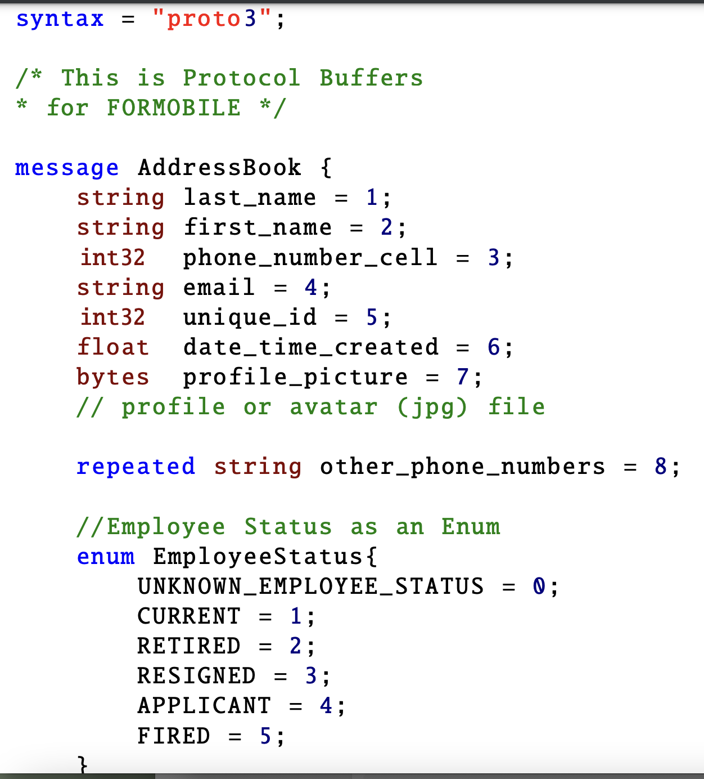

Slide 31
Nesting
Messages can be added inline into another message.
Nesting allows us to have message(s) types within a message type.
This functionality is well known in programming languages and is called aggregation.
That means some other message type is part of a second message type.

Slide 32
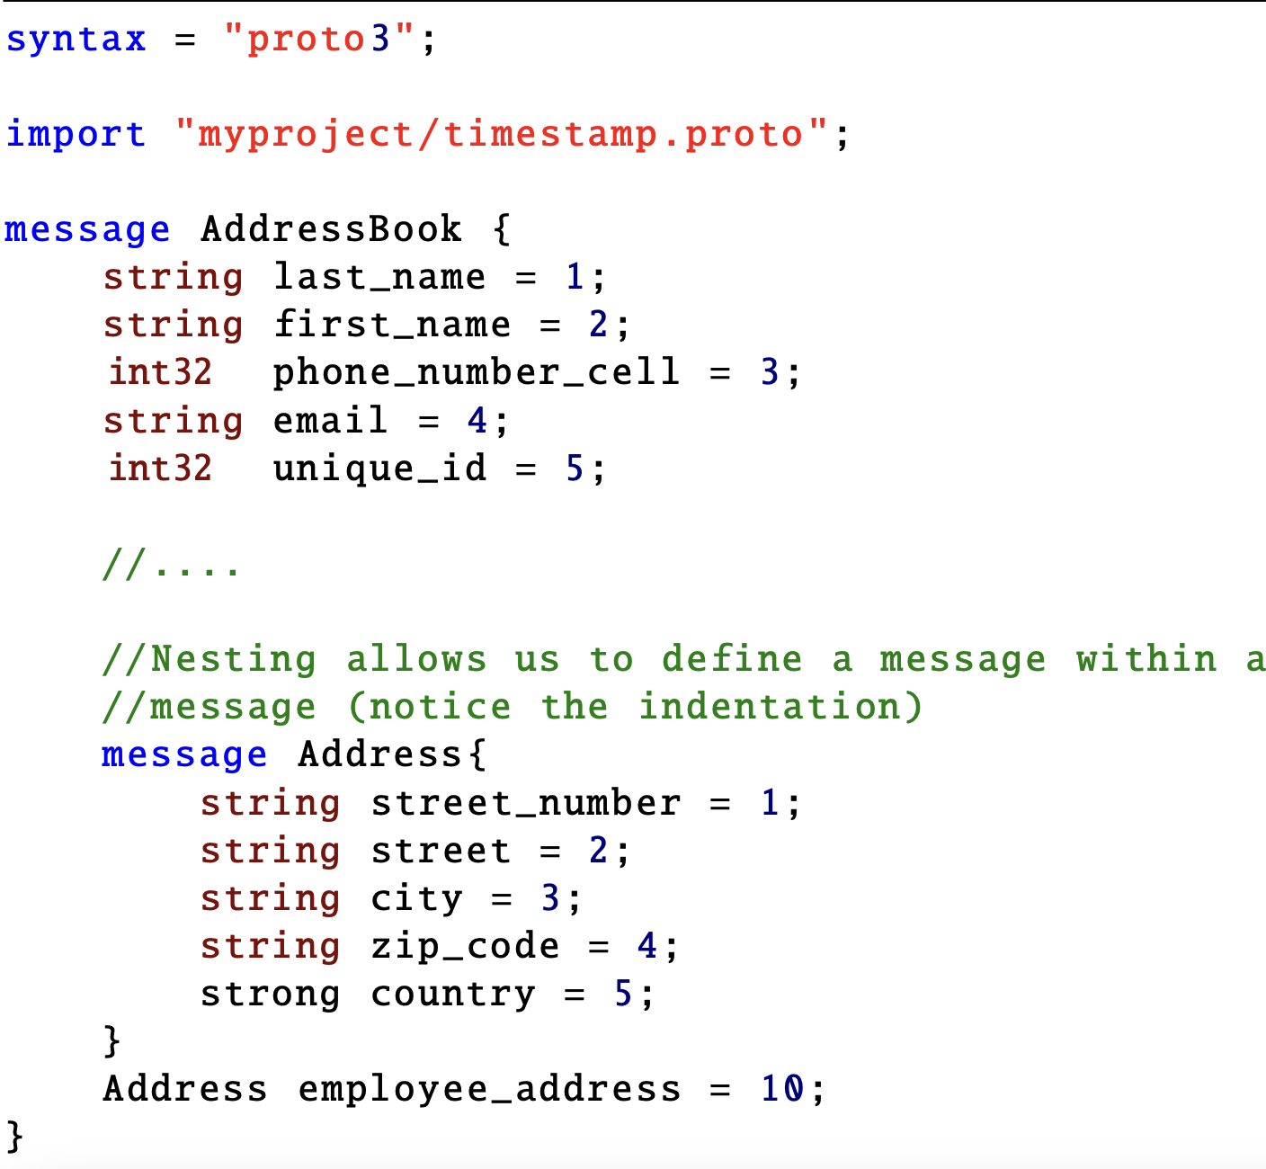

Slide 33
Importing & Packages
Importing allows us to use other .proto file(s) or package(s) with the code you need from a different proto file.
Below is a timestamp.proto file that has the set up for an epoch time stamp

Slide 34
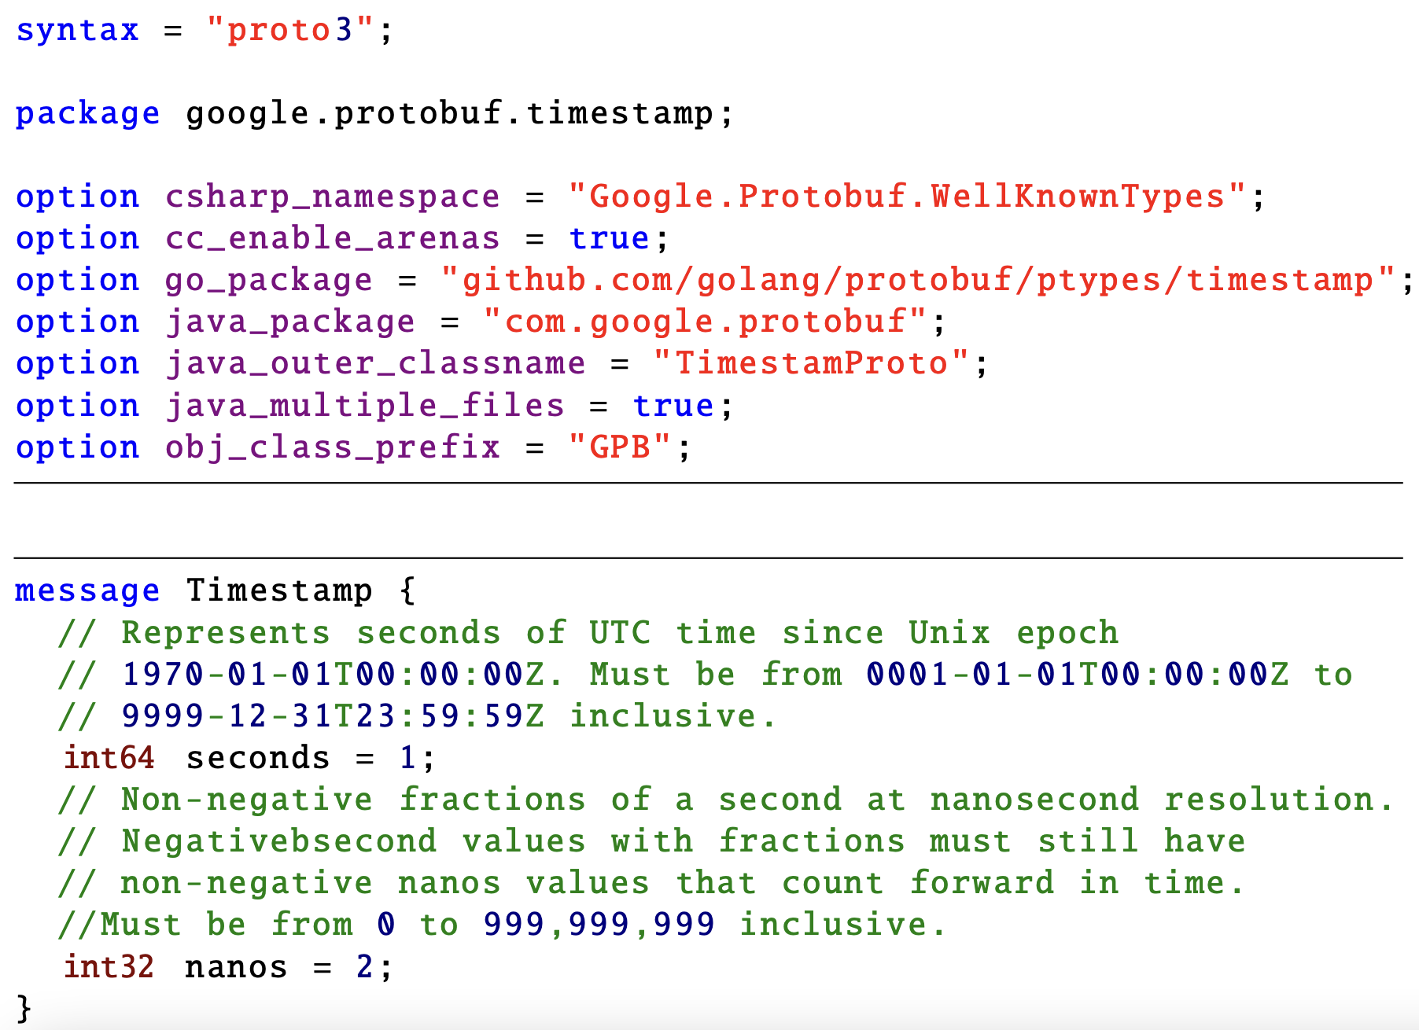

Slide 35
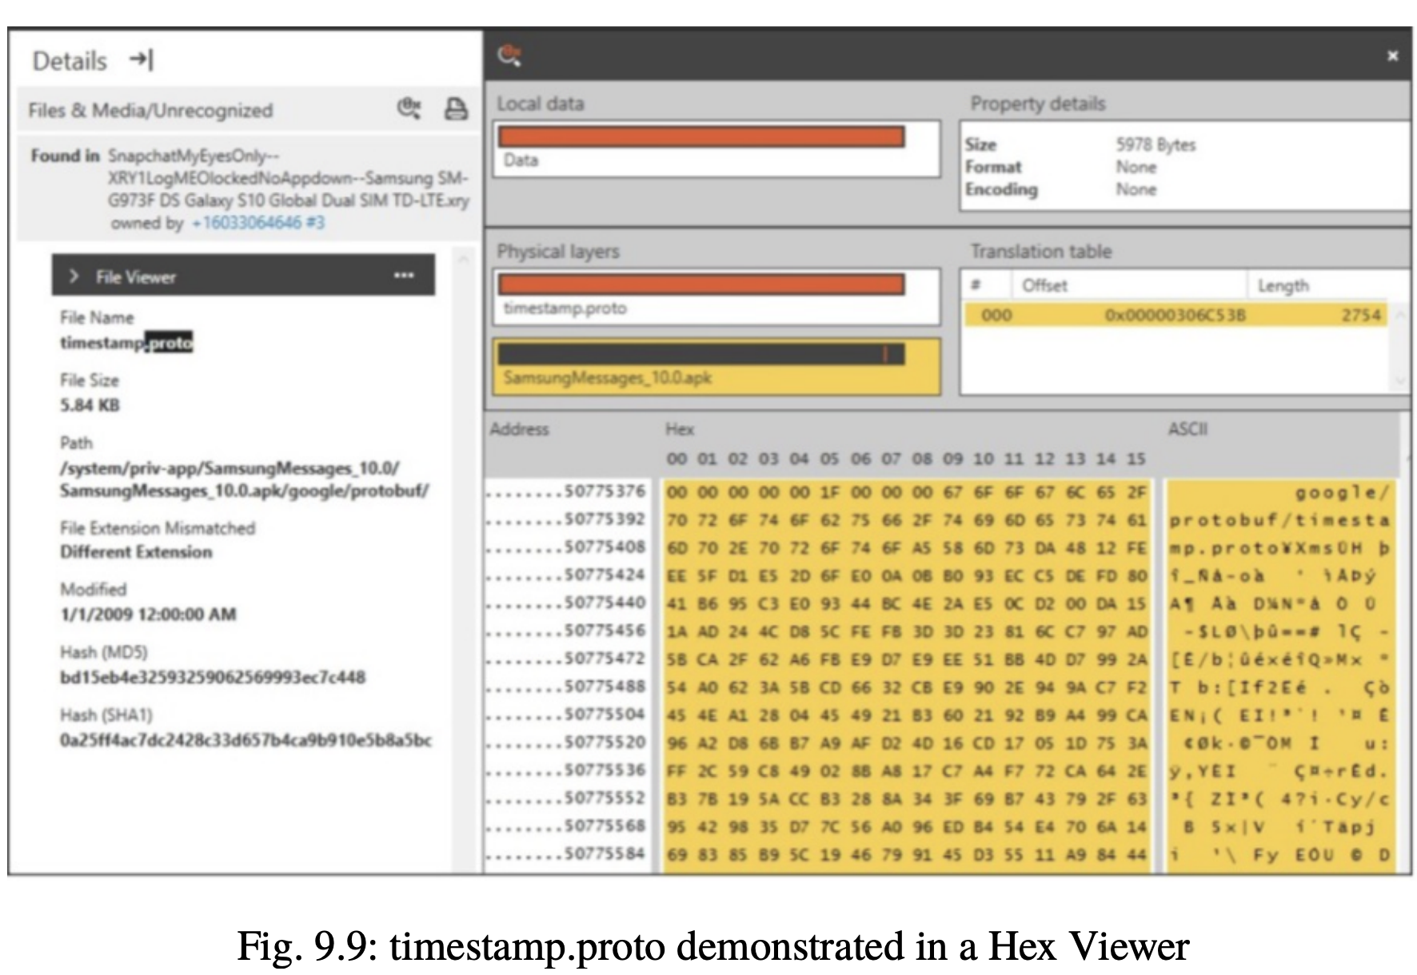

Slide 36
Compiling Your Protocol Buffer
Once the custom data structures are defined as desired in the .proto file, generate the classes needed to read and write the protobuf messages.
For this purpose, apply the protocol buffers compiler (protoc) to the configuration file.
The protoc.exe is what we will be using to look at the data that we find.

Slide 37
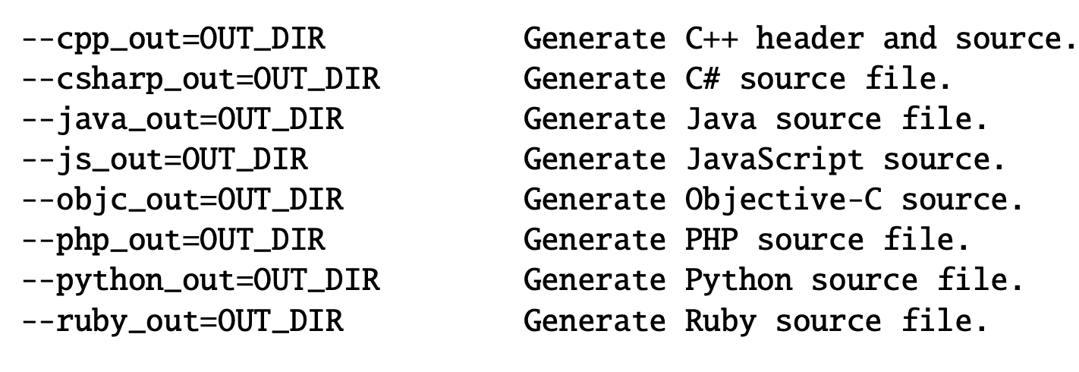
specify the directory to search for imports. It may be specified multiple times; directories will be searched in order.

Slide 38
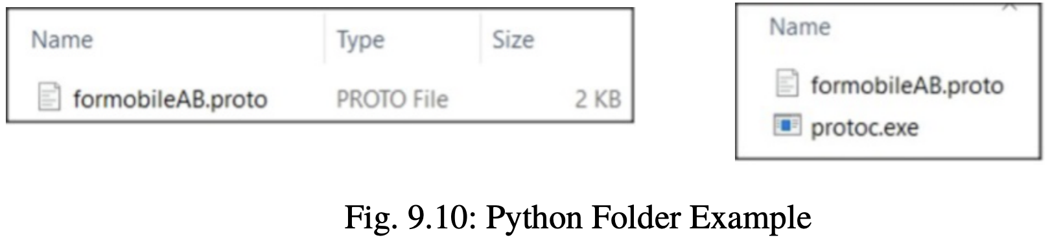
will be using Python --python_out=OUT_DIR. Other languages like GO are supported and can be found referenced online.

Slide 39
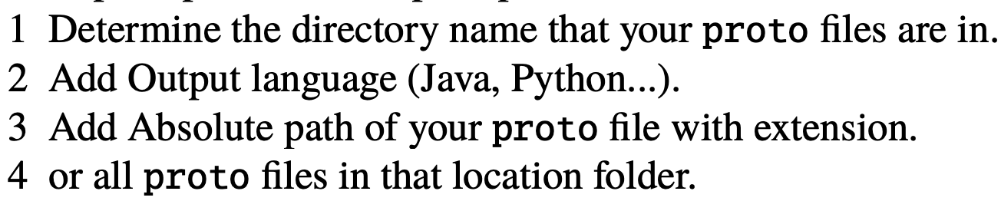
open up a command prompt in this location and follow steps 1, 2, 3 or 1, 2, 4.

Slide 40
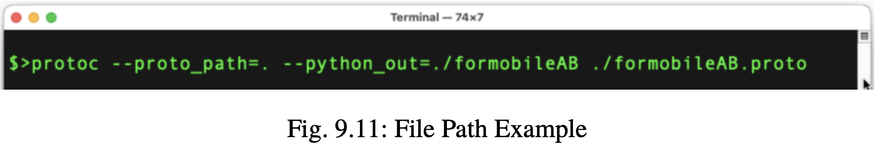

Slide 41
Creation of a Protobufs with Python
Writing the Object to a Binary File
Remember Size = Speed
The Raw Binary Data

Slide 42
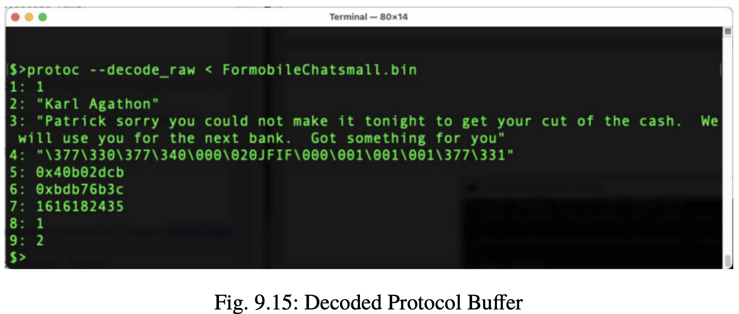
Reversing Proto Buffer Messages

Slide 43
